Slide 1
Unit 11: For Live Session Assignment

Slide 2
Part 1: Quick Quiz Questions

Slide 3

Part 1: Quick Quiz Questions

Slide 4
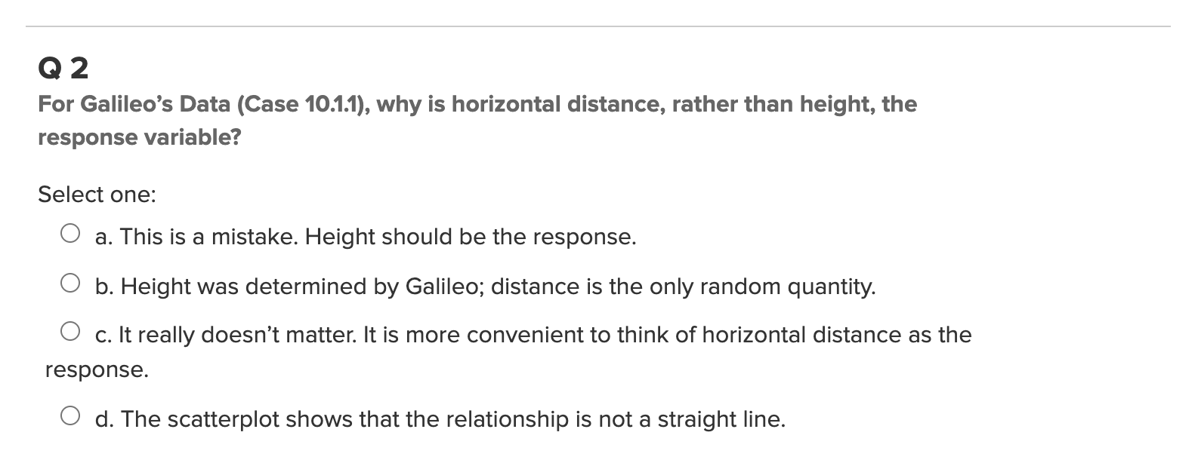
Part 1: Quick Quiz Questions

Slide 5
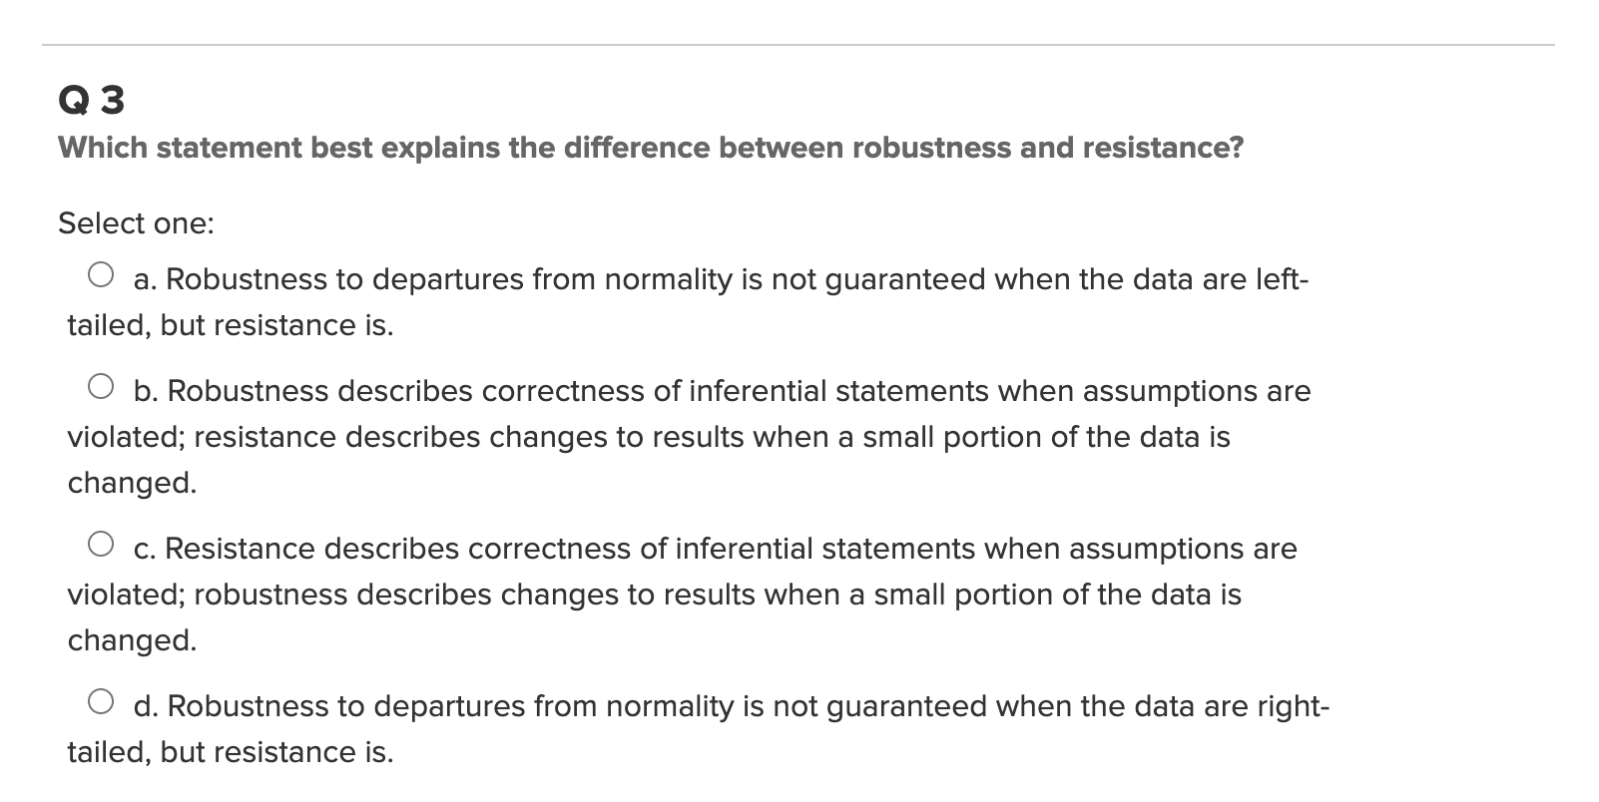
Part 1: Quick Quiz Questions

Slide 6
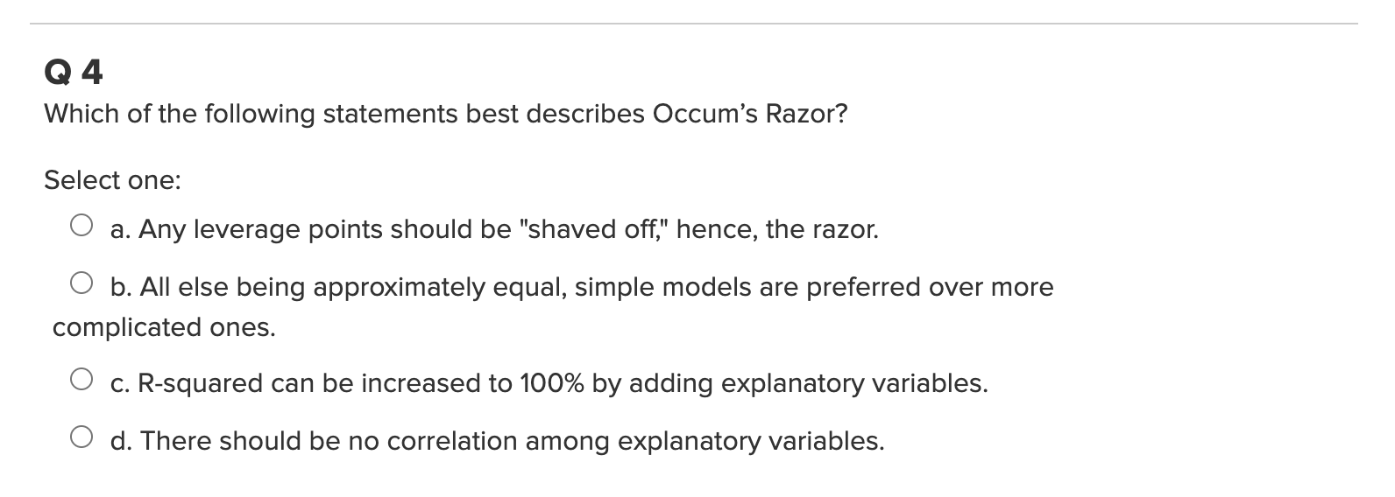
Part 1: Quick Quiz Questions

Slide 7
Part 2:Transformations!

Slide 8
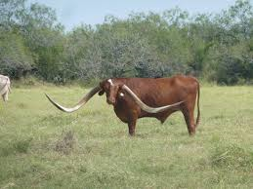
Meat Processing and pH
A certain kind of meat processing may begin once the pH in postmortem muscle of a steer carcass decreases to 6.0 from a pH at time of slaughter of around 7.0 to 7.2. It is not practical to monitor the pH decline for each animal. So, an estimate is needed of the time after slaughter at which the pH reaches 6.0. To assess the relationship between the pH and the time after slaughter, 10 steer carcasses were assigned to be measured for pH at one of five times after slaughter. For this exercise, fit a linear regression model to predict the pH given the time after slaughter. You will need to use either a linear – log, log – linear or log-log model. That is you will have to perform these transformation to deem which one is most appropriate. Fit this model and then interpret the slope parameter to assess the relationship between pH and time.

Slide 9
Part 3: Takeaways

Slide 10
Please Provide a summary of at least 4, but as many any as you like, takeaways from this unit!

Slide 11
Part 4: Questions or Comments

